Slide 1

FUNCTION OF MANAGEMENT
Prepared By:
Bhavya Bhatt
160410116014
16BEITG033
IT-1 BATCH-A
Bhavya Bhatt(160410116014)

Slide 2
Contents
Introduction
Functions of Management
Planning
Organinzing
Staffing
Directing
Controlling
Case study
Bhavya Bhatt(160410116014)

Slide 3
What is Management ?
Management means the “Art of getting things through others”.
By Many parker.
Management is the art of getting things done through and with the people in the formally organized groups.
By Harnold koontz.
Bhavya Bhatt(160410116014)

Slide 4
Five Functions of Management
Planning
Staffing
Organizing
Directing
Controlling
Bhavya Bhatt(160410116014)

Slide 5
Planning
According to Urwick, “Planning is a mental predisposition to do things in orderly way, to think before acting and to act in the light of facts rather than guesses”. Planning is deciding best alternative among others to perform different managerial functions in order to achieve predetermined goals.
According to Koontz & O’Donell, “Planning is deciding in advance what to do, how to do and who is to do it. Planning bridges the gap between where we are to, where we want to go. It makes possible things to occur which would not otherwise occur”.
Bhavya Bhatt(160410116014)

Slide 6
Planning
Planning means looking ahead and chalking out future courses of action to be followed. It is a preparatory step. It is a systematic activity which determines when, how and who is going to perform a specific job. Planning is a detailed programme regarding future courses of action.
It is rightly said “Well plan is half done”. Therefore planning takes into consideration available & prospective human and physical resources of the organization so as to get effective co-ordination, contribution & perfect adjustment. It is the basic management function which includes formulation of one or more detailed plans to achieve optimum balance of needs or demands with the available resources.
Bhavya Bhatt(160410116014)

Slide 7
Organizing
It is the process of bringing together physical, financial and human resources and developing productive relationship amongst them for achievement of organizational goals.
According to Henry Fayol, “To organize a business is to provide it with everything useful for its functioning i.e. raw material, tools, capital and personnel’s”. To organize a business involves determining & providing human and non-human resources to the organizational structure.
Bhavya Bhatt(160410116014)

Slide 8
Organizing
Organizing can be done ny the help of following steps
Identification of activities
Departmentally organizing the activities
Classifying the authority
Co-ordination between Authority and responsibility
Bhavya Bhatt(160410116014)

Slide 9
Staffing
The managerial function of staffing involves manning the organization structure through proper and effective selection, appraisal and development of the personnels to fill the roles assigned to the employers/workforce.
According to Theo Haimann, “Staffing pertains to recruitment, selection, development and compensation of subordinates.”
Bhavya Bhatt(160410116014)

Slide 10
Directing
Directing is said to be a process in which the managers instruct, guide and oversee the performance of the workers to achieve predetermined goals. Directing is said to be the heart of management process.Planning,Organizing and staffing have got no importance if direction function does not take place.
Directing initiates action and it is from here actual work starts. Direction is said to be consisting of human factors. In simple words, it can be described as providing guidance to workers is doing work. In field of management, direction is said to be all those activities which are designed to encourage the subordinates to work effectively and efficiently. According to Human, “Directing consists of process or technique by which instruction can be issued and operations can be carried out as originally planned” Therefore, Directing is the function of guiding, inspiring, overseeing and instructing people towards accomplishment of organizational goals.
Bhavya Bhatt(160410116014)

Slide 11
Directing
Supervision- implies overseeing the work of subordinates by their superiors. It is the act of watching & directing work & workers.
Motivation- means inspiring, stimulating or encouraging the sub-ordinates with zeal to work. Positive, negative, monetary, non-monetary incentives may be used for this purpose.
Leadership- may be defined as a process by which manager guides and influences the work of subordinates in desired direction.
Communications- is the process of passing information, experience, opinion etc from one person to another. It is a bridge of understanding
Bhavya Bhatt(160410116014)

Slide 12
Controlling
According to Brech, “Controlling is a systematic exercise which is called as a process of checking actual performance against the standards or plans with a view to ensure adequate progress and also recording such experience as is gained as a contribution to possible future needs.”
According to Donnell, “Just as a navigator continually takes reading to ensure whether he is relative to a planned action, so should a business manager continually take reading to assure himself that his enterprise is on right course.”
Bhavya Bhatt(160410116014)

Slide 13
Controlling
Controlling consists of verifying whether everything occurs in confirmities with the plans adopted, instructions issued and principles established. Controlling ensures that there is effective and efficient utilization of organizational resources so as to achieve the planned goals. Controlling measures the deviation of actual performance from the standard performance, discovers the causes of such deviations and helps in taking corrective actions
Bhavya Bhatt(160410116014)

Slide 14

CASE STUDY
In the year 1966 the RIL was founded by Shri Dhirubhai H.Ambani, it was started as a small textile manufacturer unit. In May 8, 1973 RIL was incorporated and conformed their name as RIL in the year 1985.
The Reliance Group, founded by Dhirubhai H. Ambani , is India's largest private sector enterprise.
The flagship company, Reliance Industries Limited, is a Fortune Global 500 company and is the largest private sector company in India.
The company operates in three business segments: petrochemicals, refining, and oil and gas. The petrochemicals segment includes production and marketing operations of petrochemical products.
Bhavya Bhatt(160410116014)

Slide 15
Planning
Planning is the first step of the function of management. Planning involves deciding in advance what has to be done, when, how and whom it has to be done and how the results are to be evaluated.
Dhirubhai Ambani epitomized the dauntless entrepreneurial spirit of a visionary always on the march to change the destiny of a nation. Dhirubhai’s unique vision redefined the potential of the Indian corporate sector and he challenged conventional wisdom in several areas.
Bhavya Bhatt(160410116014)

Slide 16
Organising
According to Haimann, "Organisation is the process of defining and grouping the activities of the enterprise and establishing the authority relationship among them."
There are two concept are prevalent about organisation. In the other word, there are two meaning of organization:
  Organising as process
  Organising as a structure of relationship
Bhavya Bhatt(160410116014)

Slide 17
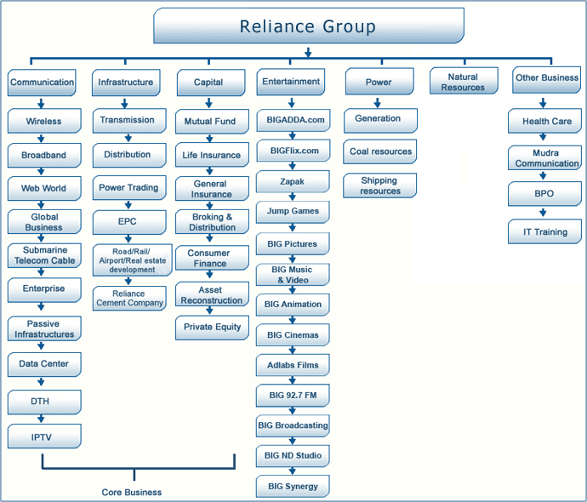
Bhavya Bhatt(160410116014)

Slide 18
3. Directing
Directing is influencing people so that they will contribute to the organisation and group goals; it has to do predominantly with the personal aspect of managing.
Leaders are a special breed of individuals who can move people toward the attainment of established goals.
Dhirubhai Ambani and Mukesh Ambani were the major leaders in development of Reliance.
Bhavya Bhatt(160410116014)

Slide 19
4. Controlling
Controlling is the management function in which performance is measured and corrective action is taken to ensure the accomplishment of organizational goals.
The basic control process involves three phases that are cyclic: establishing standards, measuring performance, and correcting deviation.
Reliance is actively being controlling its activity. Whether it may be a external or internal factor, Reliance has always tries to make the situation under control.
Bhavya Bhatt(160410116014)

Slide 20
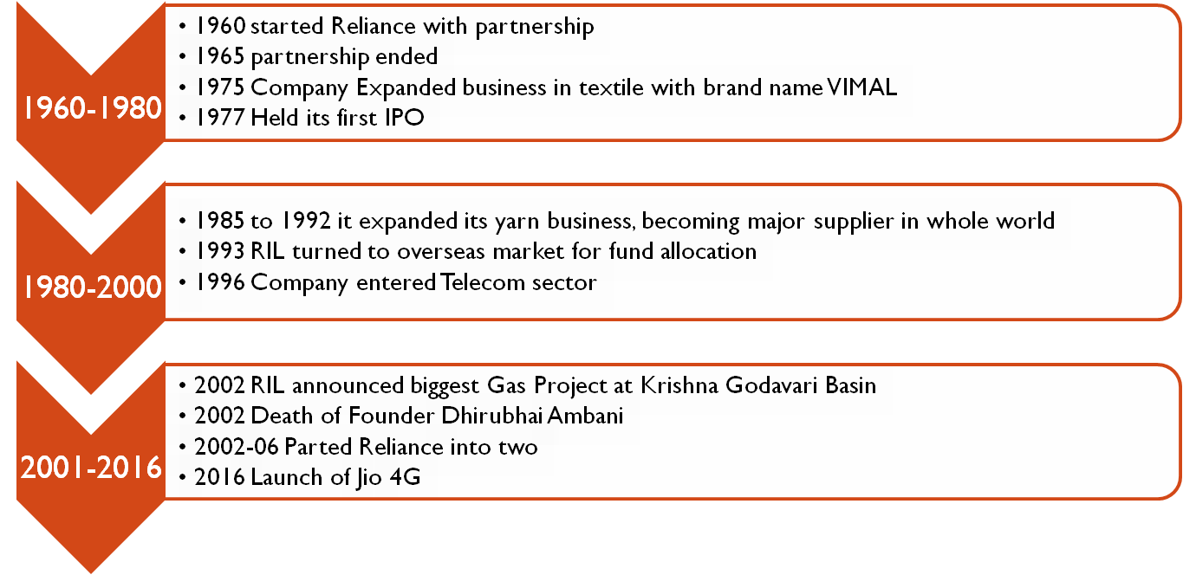
A Timeline study of Reliance performance and its resource utilization
Bhavya Bhatt(160410116014)

Slide 21

Bhavya Bhatt(160410116014)

